Slide 1
Health Monitoring
IoT System for Vehicle
Group 4
111061580張睿紘 110061635 王瑞賢
111064559 徐詠祺 111065535 楊文彣
111064539 張文彥

Slide 2
Outline
Introduction
Motivations
Target Applications
Application Scenario
Evolution
System Architecture
Technology
Sensors
Tx & Rx
DVFS
AIoT System
Industry Analysis
Conclusion
References
Team Member task partition

Slide 3

Motivation
The lack of awareness of vehicle maintenance
Higher risk of nasty accident
Spending more time and money to repair
The small vibration or signal for the early stage vehicles’ failure is hard to notice
Important information for
car insurance company

Slide 4

Target Applications
Detects early-stage failures:
Reduce the risk of breakdown
Improve machine performance
Extend machine use life
Scoring machine health and your driving habbits
Predicts failures:
Predicting machine failure from
sensors detection and users’
driving style

Slide 5

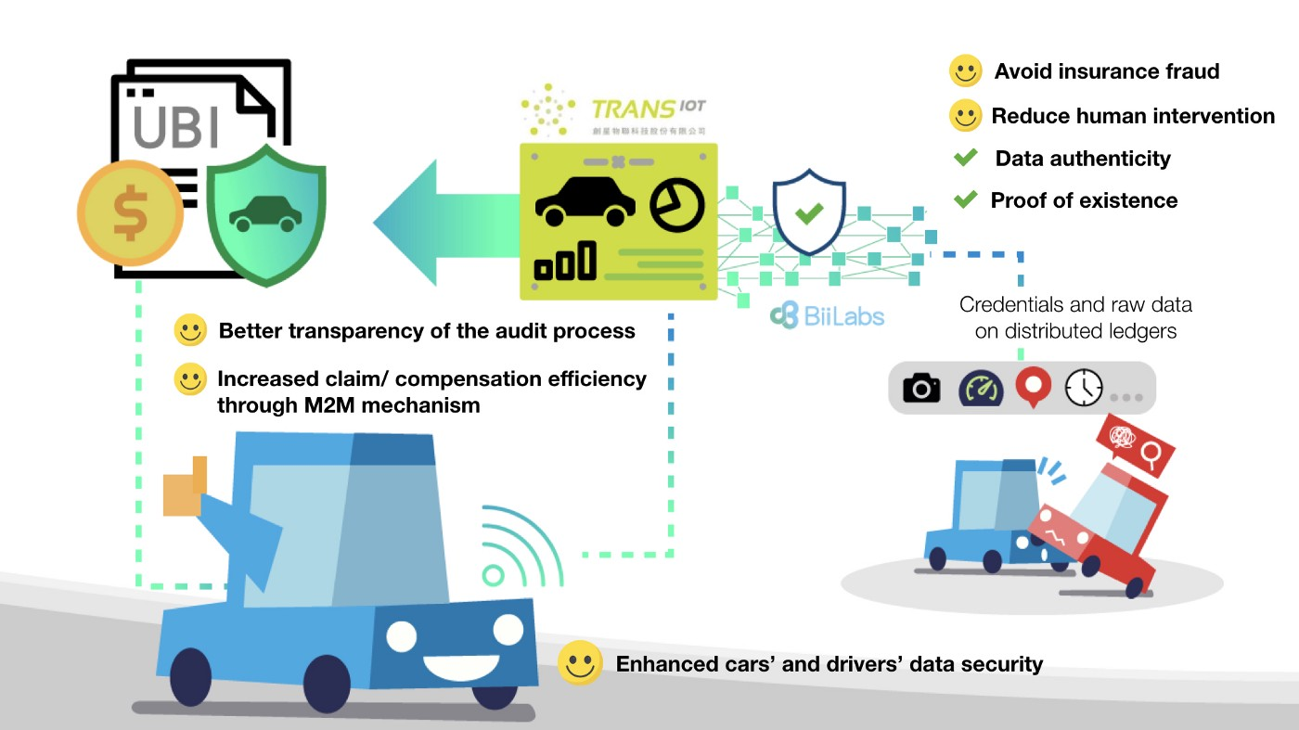
Application Scenario
Vehicle failure alert system
Usage Based Insurance

Slide 6
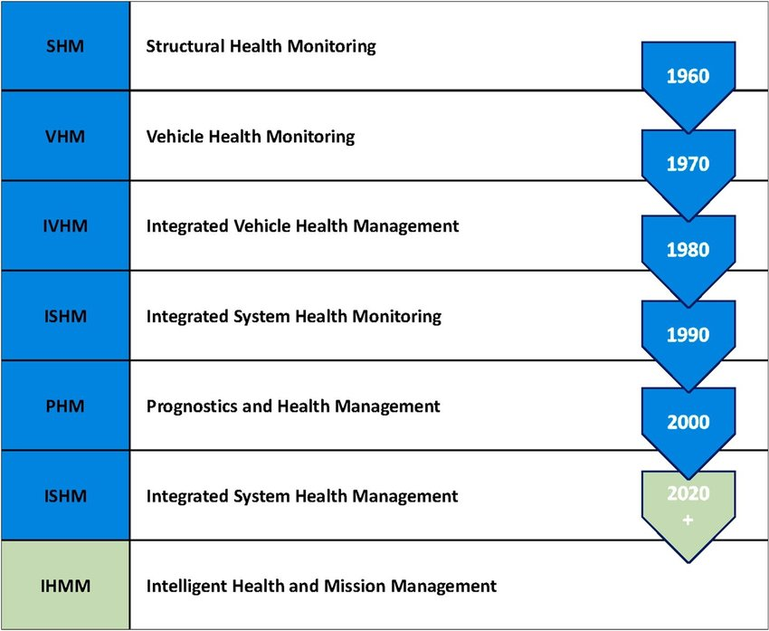
Evolution

Slide 7
System Architecture
Memory
Clock
EH-
PMU
Cloud Computing
ARM Cortex-M0+
(MCU)
FFT
Ethernet Controller
Interfaces
(I2C, SPI, ADC)
WRX
DSP
User
Devices
Sensor
TRX

Slide 8
Technology
Sensors:
Acceleration
Temperature
Humdity
Tx & Rx:
IEEE 802.11ba
Wake-up Radio receiver
Power management
Microcontroller
DVFS
Energy Harvesting
Storage Device:
Cloud Storage
Network
LTE / Wi-Fi backhaul

Slide 9
Sensors
Relative Humidity Sensor
Accelerometer
Magnetometer
Thermistor

Slide 10
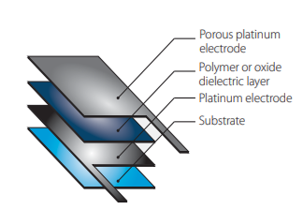
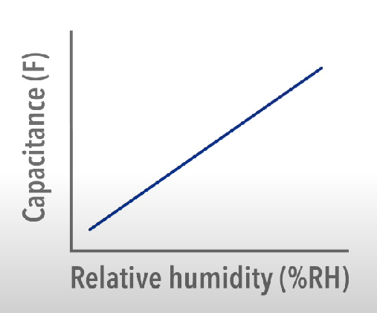
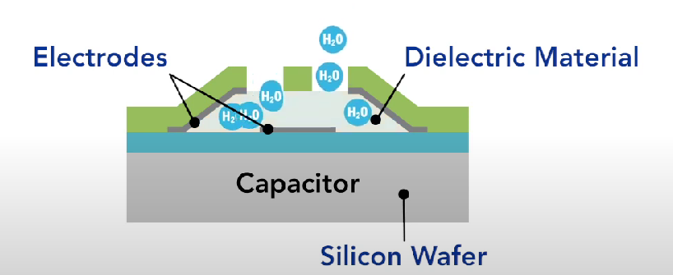
Relative Humidity Sensor
Capacitive humidity sensor
Dielectric layer absorbing moisture from air
Wide range detection from 0% to 100%
Low power, Linear output, High stability
Temperature dependence (combined with temp sensor)

Slide 11
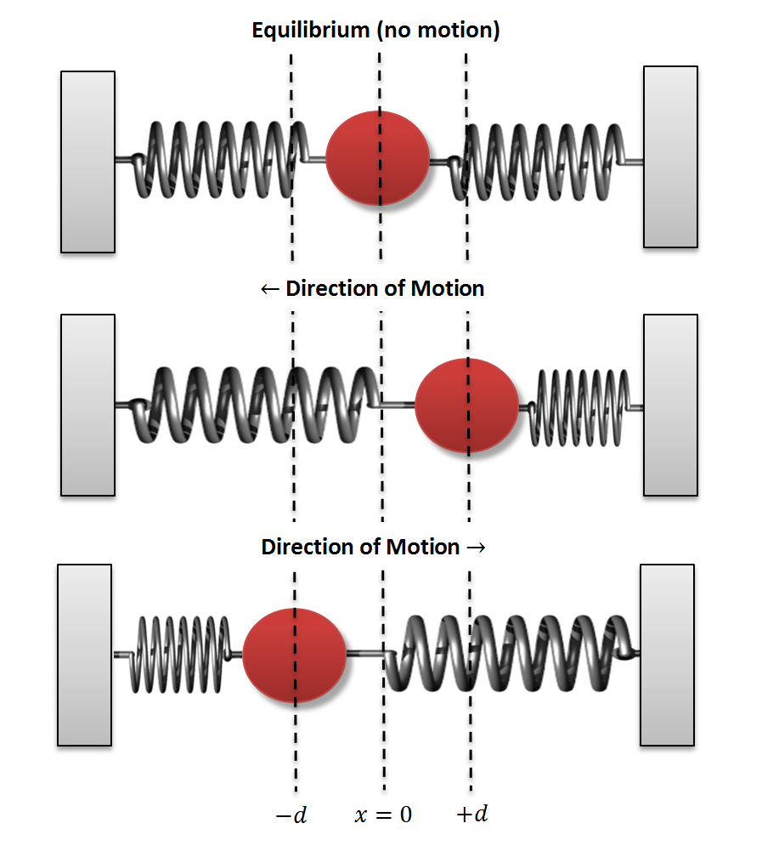
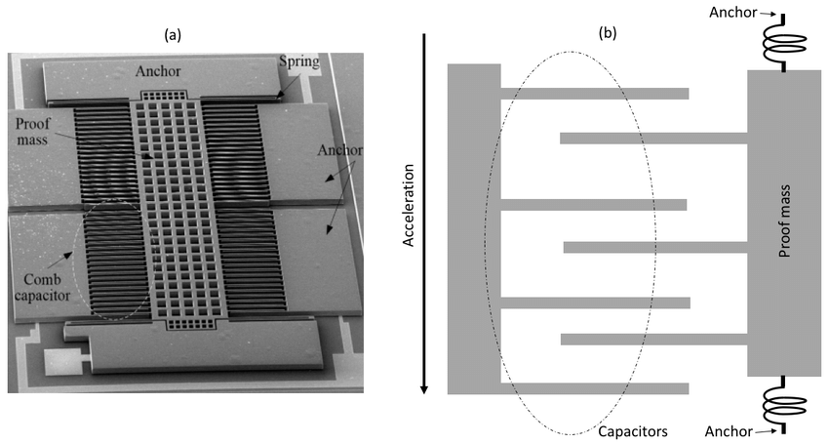
Accelerometer
Capacitive Accelerometer
Movement changes capacitance between mass & comb fingers
Proof of mass + Comb capacitor + Spring

Slide 12
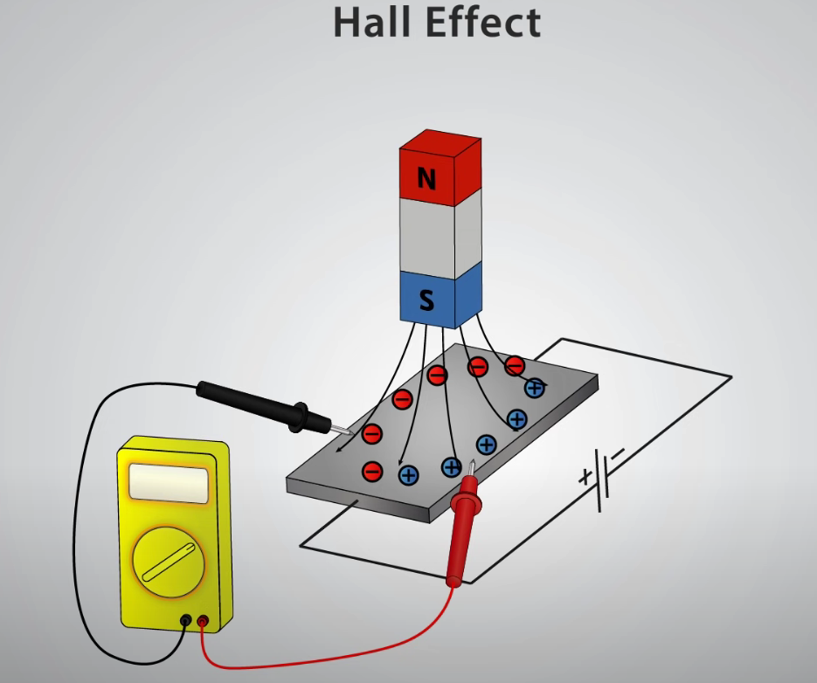
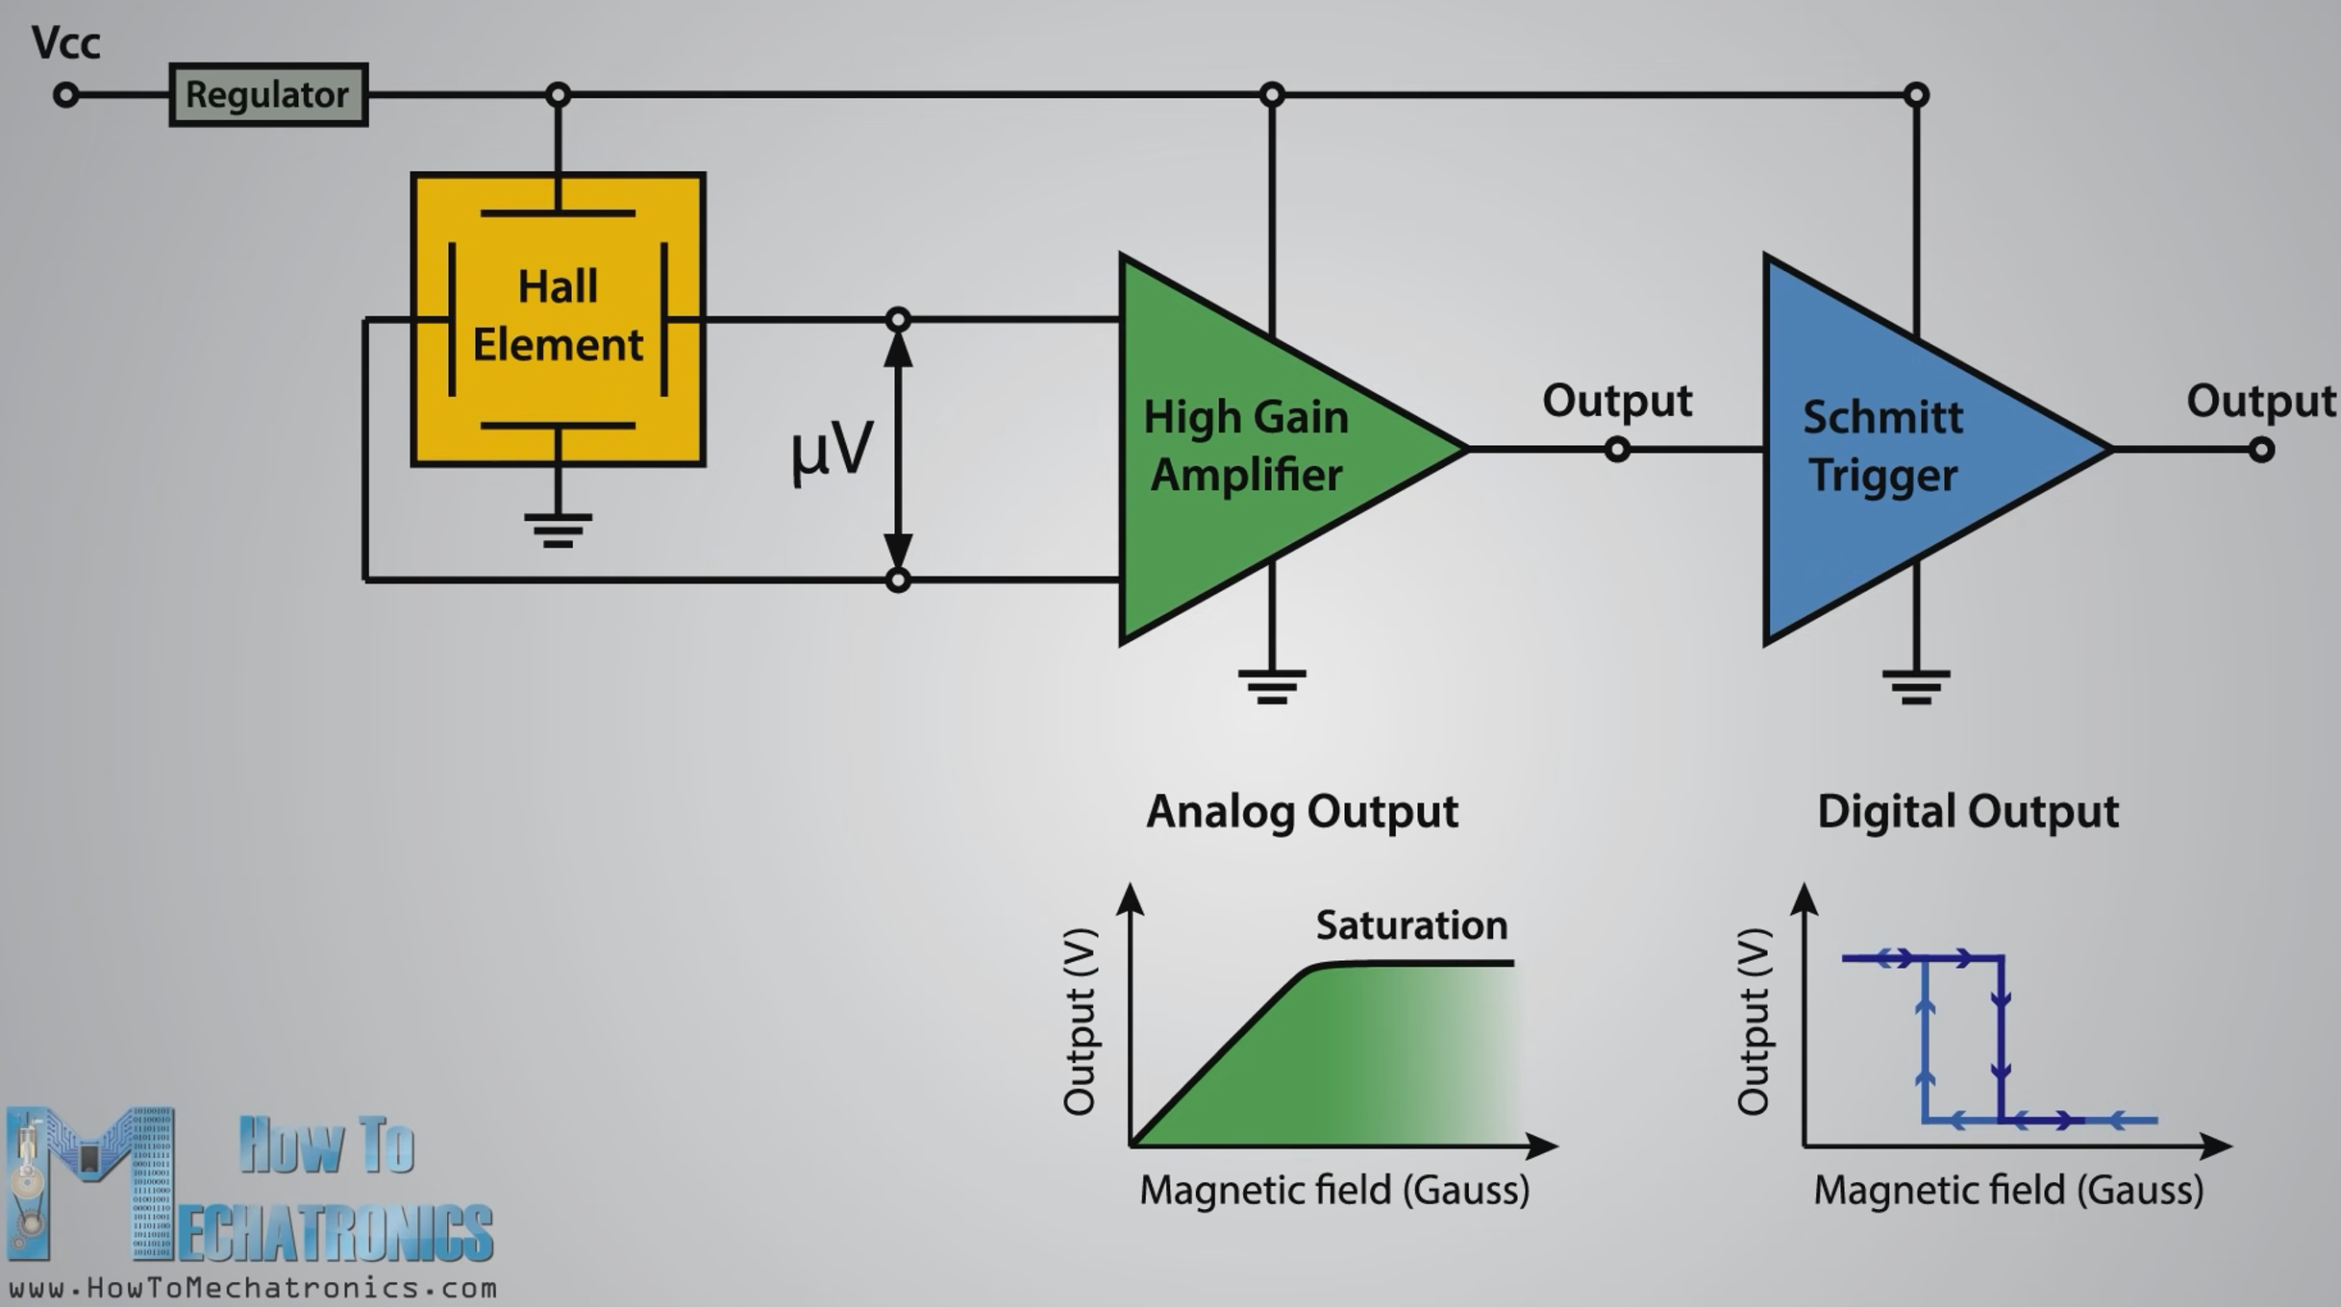
Magnetometer
Hall Effect Magnetometer
Drift voltage caused by Lorentz force when a magnetic field is present
Amplifier is needed due to small drift voltage
Schmitt trigger to resist noise & bounce

Slide 13
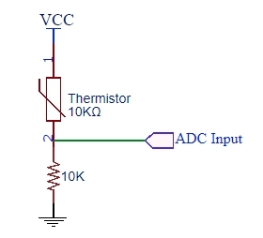
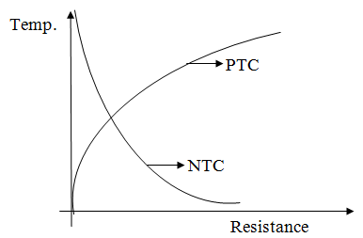
Thermistor
2 basic types:
Positive Temperature Coefficient (PTC)
Negative Temperature Coefficient (NTC)
Temperature range: −100 °C and 300 °C
Monitoring temperature by ADC

Slide 14
Operation Flow
Target: continuous monitoring in varying condition
Extracting information on chip through calculation
Interface: I2C, SPI, ADC
Controller
wake
Sensors
raw data
Cal Unit
(ex: FFT)
message
TX

Slide 15
Tx & Rx
Wake-Up Radio
IEEE 802.11ba
Wake-Up Radio system architecture
WuRx wake-up circuit

Slide 16
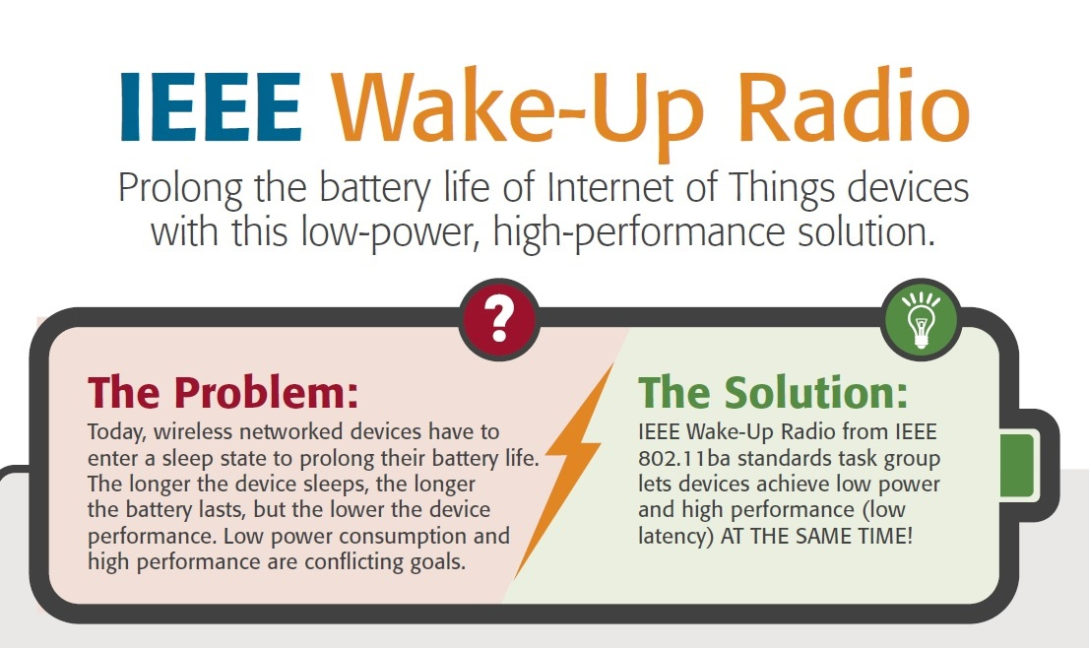
Wake-Up Radio

Slide 17
IEEE 802.11ba
July to November 2016, the scope and targets of the standard were defined. There are three key requirements:
The Wake-Up Radio (WuR) power < 1mW.
The WuR should coexist with legacy IEEE 802.11 devices in the same band.
The WuR should meet the same range requirement as the primary connectivity radio.

Slide 18
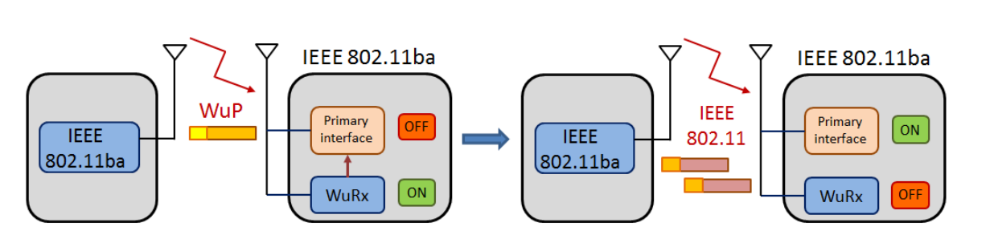
Wake-Up Radio system architecture
The primary radio of an IEEE 802.11ba-capable low-power device is put to sleep in order to save energy
When the sleeping device is required, a packet is sent in order to generate a call to wake up the device’s primary radio

Slide 19
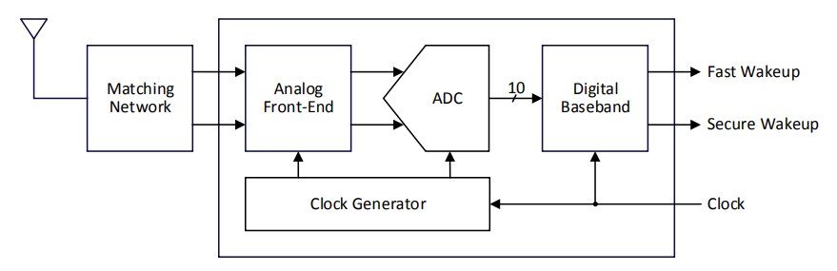
WuRx wake-up circuit
An off-chip matching network to provide passive gain into the analog front-end
SAR ADC and digital baseband issue fast wakeup or secure wakeup signal to MCU

Slide 20
Power Management
Microcontroller
DVFS
Energy Harvesting

Slide 21
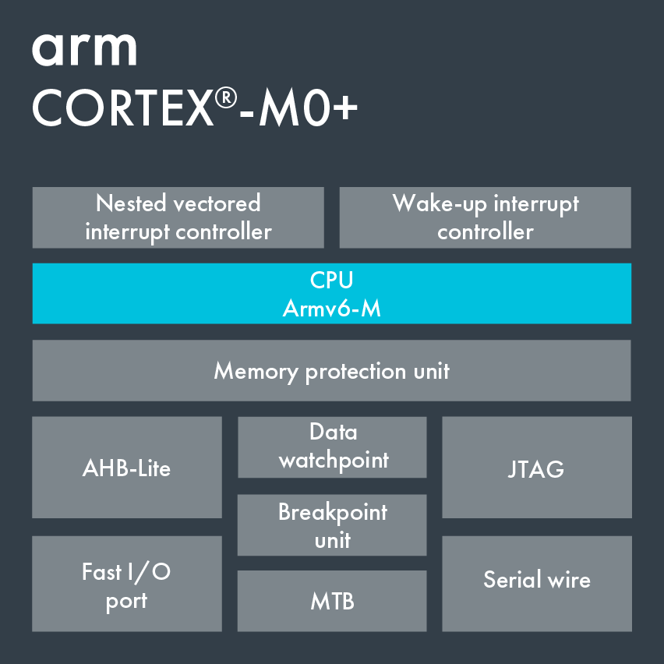
Microcontroller
Three Sleep modes
Normal Sleep
Deep Sleep
(Wake up Interrupt Controller (WIC))
Deep Sleep with State Retention Power Gating (SRPG) support (WIC + SRPG)

Slide 22
Microcontroller
Feature of Cortex M0+ :
Similar size and programmer’s model to Cortex M0
Low gate count same as Cortex M0
Two-stage pipeline (more low energy consumption)
Memory Protection

Slide 23
DVFS
DVFS is dynamic voltage frequency adjustment, and dynamic technology is to dynamically adjust the operating frequency and voltage of the chip
Adjustment Steps:
When power needs to be boosted
When power needs to be reduced
Increase the supply voltage
Increase the clock frequency
Reduce the clock frequency
Reduce the supply voltage

Slide 24


Energy Harvesting
Multi-modal energy-harvesting power management unit
(EH-PMU) with supercapacitor
Harvest from:
EM (electromagnetic) coil
Photovoltaic (PV) cell
Thermoelectricgenerator (TEG)
Vibration
RF energy

Slide 25
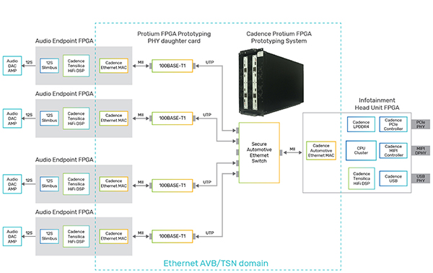
Automotive Ethernet
The automotive industry has adopted Ethernet for in-vehicle networking (IVN) based on open IEEE standards.
Notes:
Cadence offers a variety of IP to support Automotive Ethernet applications (Figure 1). For example, you can design high-speed automotive Ethernet communication links between advanced driver assistance systems (ADAS), infotainment, cameras, and other electronic control units (ECUs) by leveraging the Cadence® Ethernet controller.

Slide 26
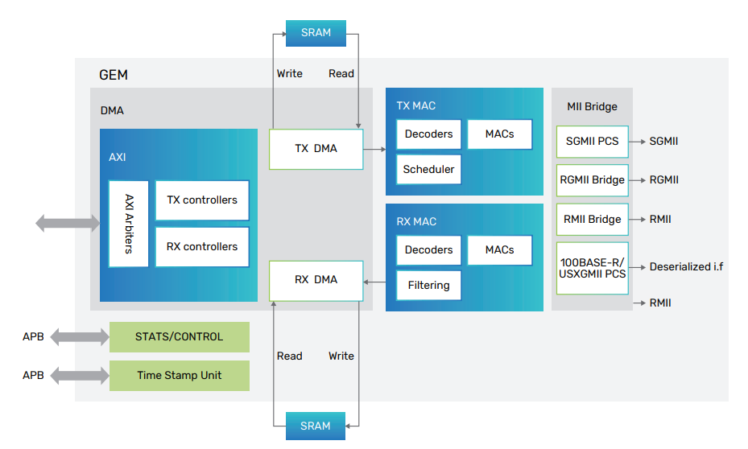
Automotive Ethernet
10G/2.5G/1G Multi-Speed Ethernet Controller IP for Automotive Applications from Cadence
Notes:
The Controller IP for Automotive is engineered to be quickly and easily integrated into any SoC. As shown below, the Controller IP for Automotive connects to a PHY through standard media independent interfaces such as MII, RMII, GMII, RGMII, XGMII, SGMII, or USXGMII. The host layer access to the Controller IP for Automotive is through industry-standard AXI or AHB interfaces when the DMA is being used or through an external FIFO interface. A separate APB interface allows the host applications to configure the Controller IP for Automotive.

Slide 27
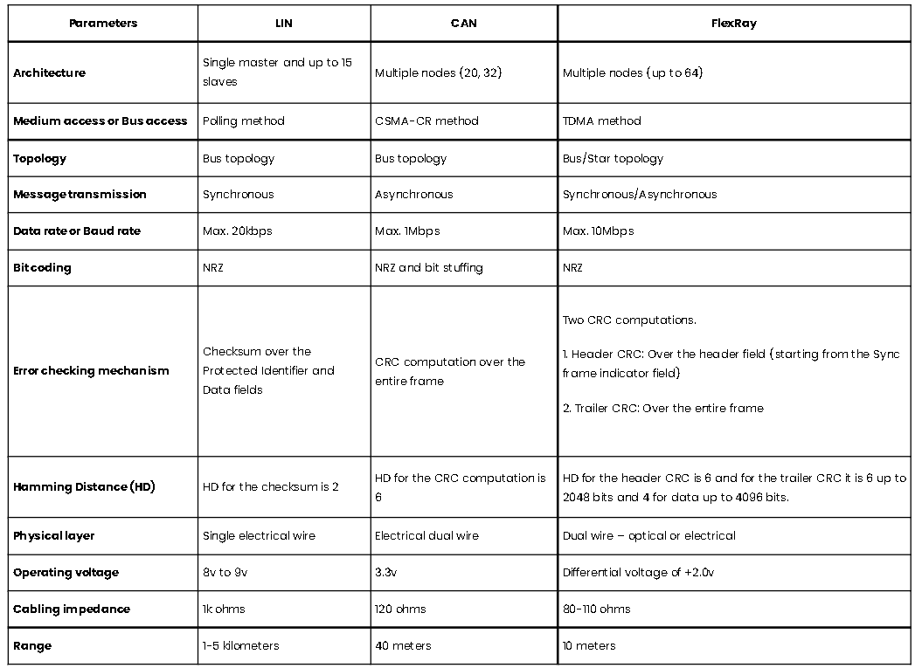
Communication Protocols
Notes:
LIN Protocol: LIN stands for Local Interconnect Network; it is a serial communication and low-cost protocol for various low speed and non-critical electronic applications in an automobile. It is a master-slave type of communication based on polling strategy (like UART) and it is half-duplex or one way communication at a given time. There are 1 Master and up to 15 slaves on a LIN bus. The communication between Master and Slaves happens through a fixed frame structure initiated by the master always. The slave/(s) respond to the header accordingly. It is important to note that, sometimes the master can respond to its own header.
CAN Protocol: CAN stands for Controller Area Network, which is a serial communication protocol supporting distributed real-time control with a very high level of security and efficiency. It is a broadcast type of protocol, in which the concept of ‘Master’ and ‘Slave’ is not present. The communication between nodes happens in a fixed frame structure. Any device/node having an update over a specific activity from any application could transmit the corresponding frame and every other device/node on the bus could read this frame and respond to it correspondingly. During such a situation, conflict on the bus is inevitable. This is resolved by ‘bit-wise arbitration’.
FlexRay Protocol: FlexRay is a fault-tolerant, deterministic, and high-speed automotive networking serial communication protocol. The fundamental idea of designing the FlexRay protocol was to meet the high-speed requirements of various applications in an automobile. Even in this protocol, there are multiple nodes trying to communicate and there is no master slave concept present. Each node is given a specific time during which the communication happens. A fixed frame structure is used to communicate between the nodes.

Slide 28
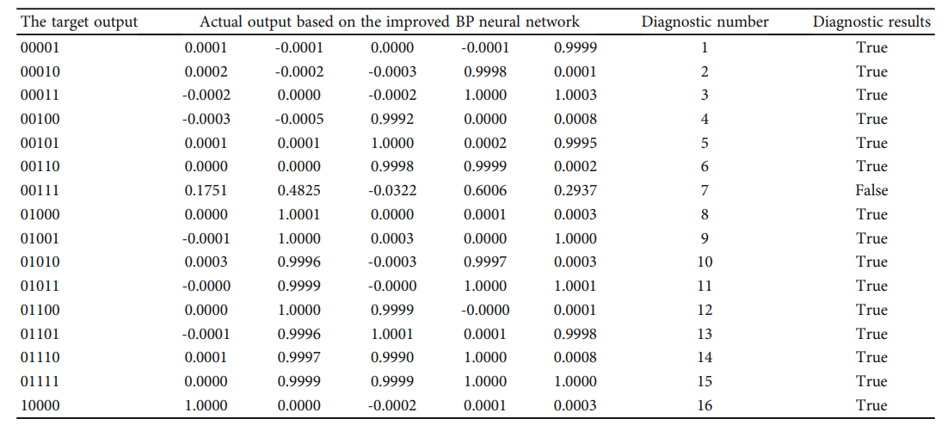
Neural Network
Improved BP (Back-propagation) Neural Network
The average absolute error of the traditional BP neural network algorithm is 0.5976, The average absolute error of the traditional BP neural network algorithm is 0.5976
Notes:
WCMC_2287776 1..11 (hindawi.com)

Slide 29
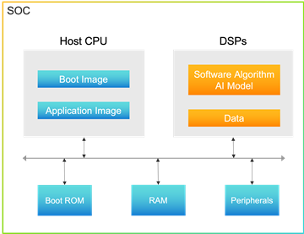
Neural Network
Software IP and data that needs protection are stored as encrypted hash to ensure security

Slide 30

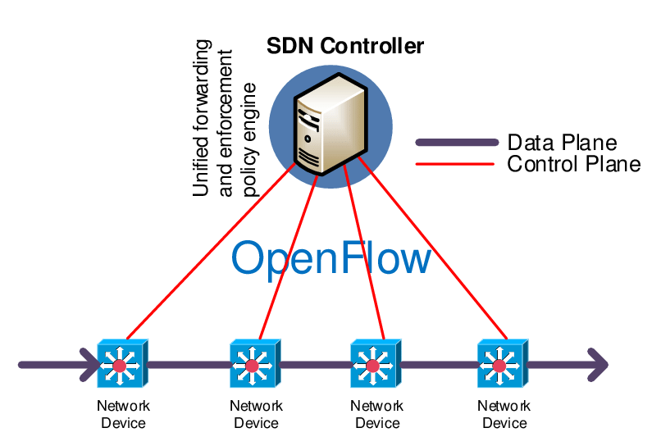
Outbound Data Flow
AT&T In-Car WiFi
An Internet data plan working with your vehicle’s built-in Wi-Fi hotspot
In-car Wi-Fi turns your vehicle into a Wi-Fi hotspot with fast, reliable internet access even when you’re far from home.
The collected components’ data are sent through WiFi to the data center for predicting component failure.
Notes:
Most new cars in 2020 come with either embedded (built-in) or tethered (brought-in) internet connectivity, or a mixture of both. Vehicles with embedded connectivity are equipped with a built-in modem to directly receive cellular data, while those with tethered connectivity borrow the driver’s smartphone data to access the Internet (similar to WI-FI hotspots).
AT&T In-car Wi-Fi is an internet data plan that works with your vehicle’s built-in Wi-Fi hotspot. Select a plan to start using your car’s Wi-Fi-enabled features, and let your passengers watch movies, play games, and more—each from their favorite screen.

Slide 31
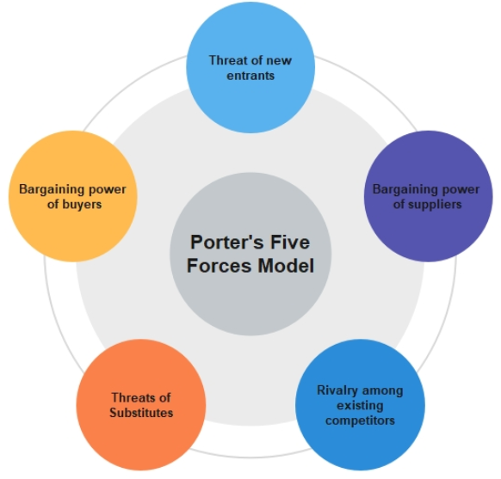
Industry analysis
1. Competition in the industry
2. Potential of new entrants into the industry
3. Bargaining power of suppliers
4. Bargaining power of customers
5. Threat of substitute products

Slide 32
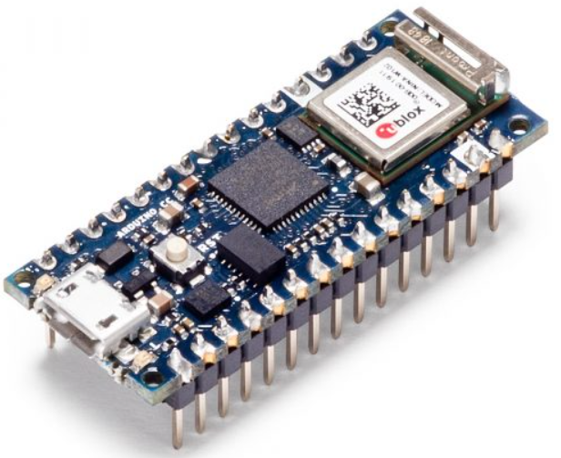
Industry analysis
1. Competition in the industry
Medium, fewer similar products in the early stage.
2. Potential of new entrants into the industry
High, because the will be more manufacturers investing in research and development.

Slide 33

Industry analysis
3. Bargaining power of suppliers
High, it’s a important safety issue to vehicle.
4. Bargaining power of customers
Low, because of the Novelty of product.

Slide 34

Industry analysis
5. Threat of substitute products
Medium, Some functions for diagnosing the health of components are now integrated into the car chip.

Slide 35
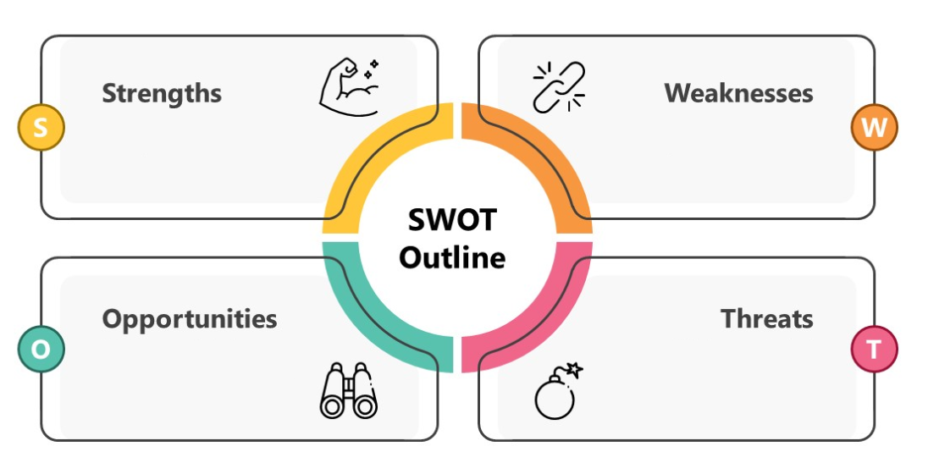
Industry analysis
1.It can respond to problems in the car faster than manual inspection
2.A safe driving environment is important
1.Long product life cycle
2.Severe standard of safety issue makes a higher cost
1.The growing market size of electric vehicle
2.Attract investment cooperation from insurance companies
1.Diagnosing the health of components may be integrated into the car chip.

Slide 36
Conclusion
Planning the SoC that combines with multiple functions for responding to different situations during driving
Vary types of sensors that can detect vehicles’ health
WRX design for fast respond and power management
DVFS and energy harvesting technology focus on further low-power SoC design
AIoT collects and computes the data generated by the SoC for different kinds of applications

Slide 37
References
Sensors
https://www.allaboutcircuits.com/technical-articles/mems-ic-capacitive-humidity-sensor-basics/
https://www.siliconsensing.com/technology/mems-accelerometers/
https://www.youtube.com/watch?v=wpAA3qeOYiI
https://www.analog.com/en/design-notes/a-simple-thermistor-interface-to-an-adc.html
Tx & Rx
“IEEE 802.11-Enabled Wake-Up Radio: Use Cases and Applications”
https://wics.engin.umich.edu/wp-content/uploads/sites/35/2020/05/Brown_ISSCC2020.pdf
https://innovationatwork.ieee.org/wake-up-radio-infographic/
https://www.ericsson.com/en/blog/2017/12/wake-up-radio--a-key-component-of-iot
“Low-Power RFED Wake-Up Receiver Design for Low-Cost Wireless Sensor Network Applications”
"Communication Integrated Circuits."

Slide 38
References
AIoT System
https://www.hindawi.com/journals/wcmc/2022/2287776/
https://www.cadence.com/zh_TW/home/solutions/automotive-solution.html
https://community.cadence.com/cadence_blogs_8/b/breakfast-bytes/posts/tensilica-security
https://www.cadence.com/content/dam/cadence-www/global/en_US/documents/tools/ip/design-ip/multi-speed-ethernet-automotive-application-ip-br.pdf
https://prodigytechno.com/difference-between-lin-can-and-flexray-protocols/
https://www.2cm.com.tw/2cm/zh-tw/archives/4E0D19A85F744843ADB63C5D2C65F080
https://www.allaboutcircuits.com/technical-articles/mems-ic-capacitive-humidity-sensor-basics/
https://link.springer.com/chapter/10.1007/978-981-16-2354-7_34
Power Management
The definitive guide to ARM Cortex-M0/M0+: Low-power states - Embedded.com
Arm Cortex-M0+ Sleep Modes - Developer Help (microchipdeveloper.com)
Dynamic Voltage and Frequency Scaling (DVFS) - Semiconductor Engineering (semiengineering.com)
https://zh.wikipedia.org/zh-tw/%E5%8A%A8%E6%80%81%E6%97%B6%E9%92%9F%E9%A2%91%E7%8E%87%E8%B0%83%E6%95%B4

Slide 39
Team Member task partition
Introduction -all
System Architecture -all
Technology
Sensors -徐詠祺
Tx & Rx -張睿紘
DVFS -張文彥
AIoT System -楊文彣
Industry Analysis -王瑞賢
Conclusion -all

